Slide 1


AI-Powered Growth for MSPs
AI Activation Playbook for MSPs
Notes:
🌍 1. Opening Context
“We’re seeing a huge push among MSPs to lead their customers into AI adoption. Hatz helps MSPs bring secure, business-ready AI to their clients — not just individual use cases, but organization-wide adoption.”
⸻
💬 2. Core Discovery Questions
🏢 Business Overview
• Tell me a bit about your business — size, customer base, and how you currently support them with cloud, security, or productivity tools.
• How are you seeing AI come into your customers’ world? Are they asking about it yet?
• Have you started thinking about AI as a service or revenue stream for your MSP?

Slide 2
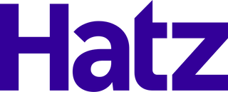

How we put MSPs in the AI Business
01
02
03
Curation of AI Tools
Secure AI
Sales Acceleration

Slide 3




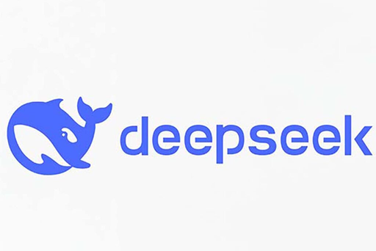



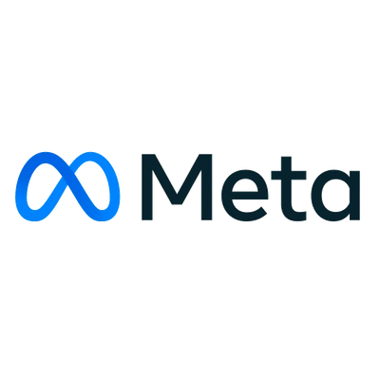
Curation of AI in One Platform
Secure AI platform
58 AI Models in 1 place
AI education
AI adoption framework
Chat with AI | Manage AI Agents | Build No-Code Workflows

Slide 4
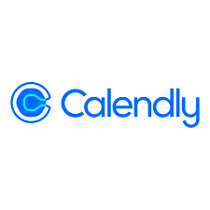

















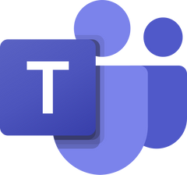




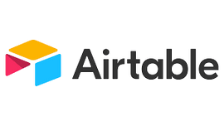




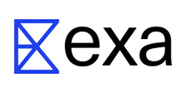
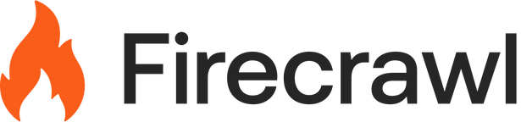



Integrations With Your Tech
...and more!

Slide 5

What problems to solve for first
Important to move quick
Security
AI Adoption
Shadow AI is already happening. Employees use free tools and risk exposing sensitive data.
Even if you have AI access, the challenge is getting the whole team to actually use it effectively.

Slide 6
How to solve
01
02
03
Secure AI environment for all your team
Track adoption
and usage
Training and use-case development for real business value

Slide 7
How We Think About AI Adoption
CRAWL
WALK
RUN
AI Use Cases:
That have immediate realization of time to value.
That work for a large portion of the company.
AI Use Cases:
That are similar but require customization and hand holding.
That take more time to implement but can be recreated in multiple areas.
AI Use Cases:
That are unique to a specific person or business unit.
That have high impact but require specialty implementation.
Meet Your Staff Where They Are

Slide 8
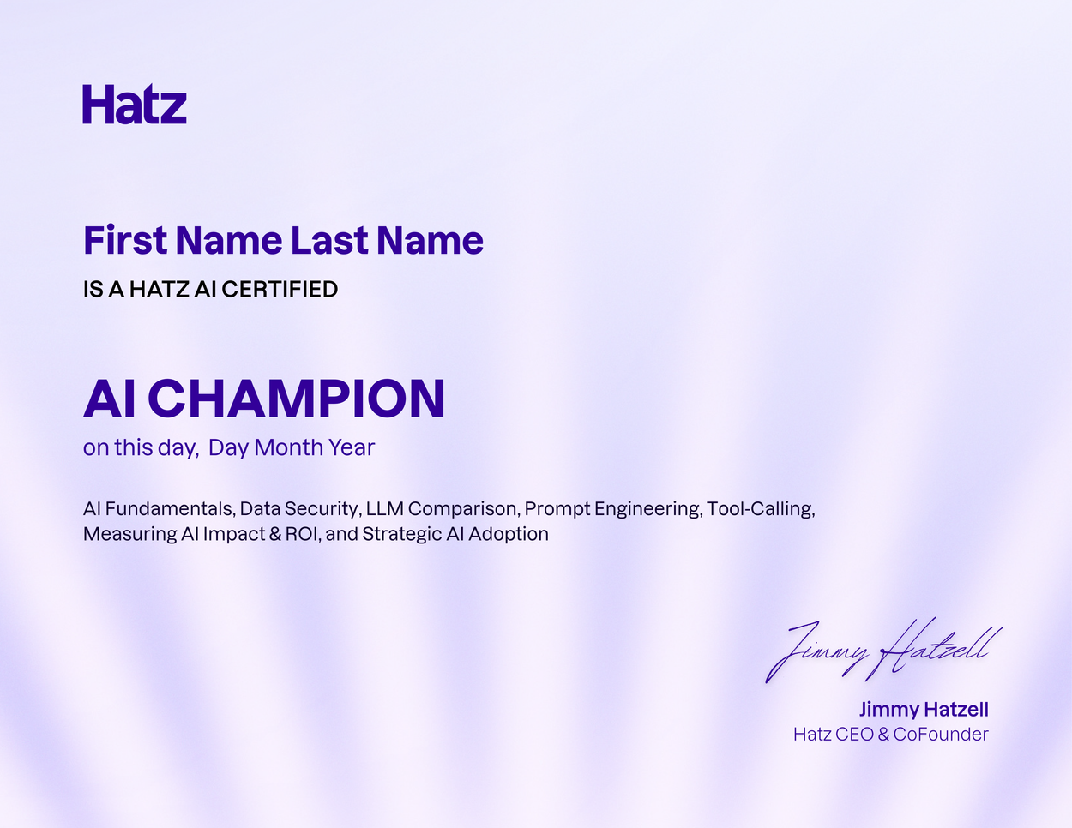
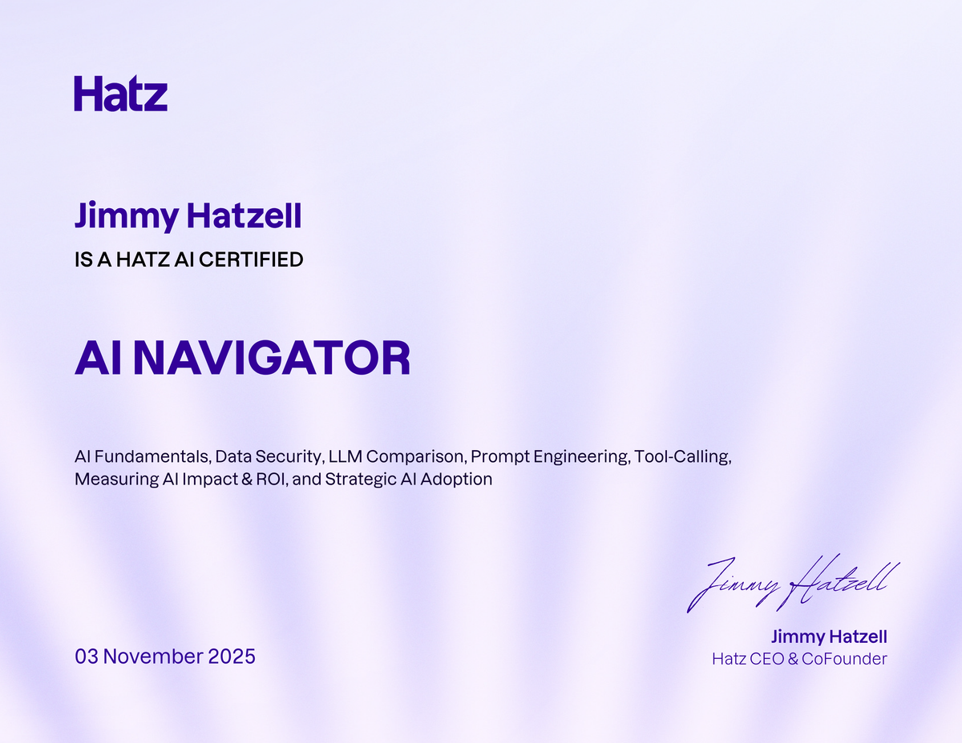
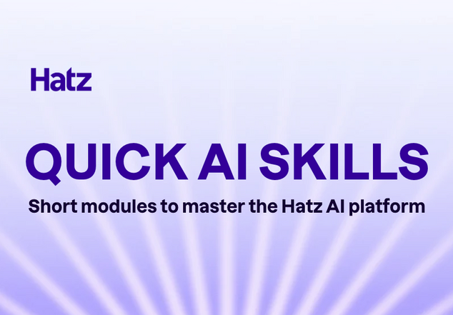
Onboarding
A 60-minute AI education ‘onboarding’ for your MSP and your clients
Baseline AI IQ
Onboard w/Hatz
Build your skillz
1
2
3

Slide 9



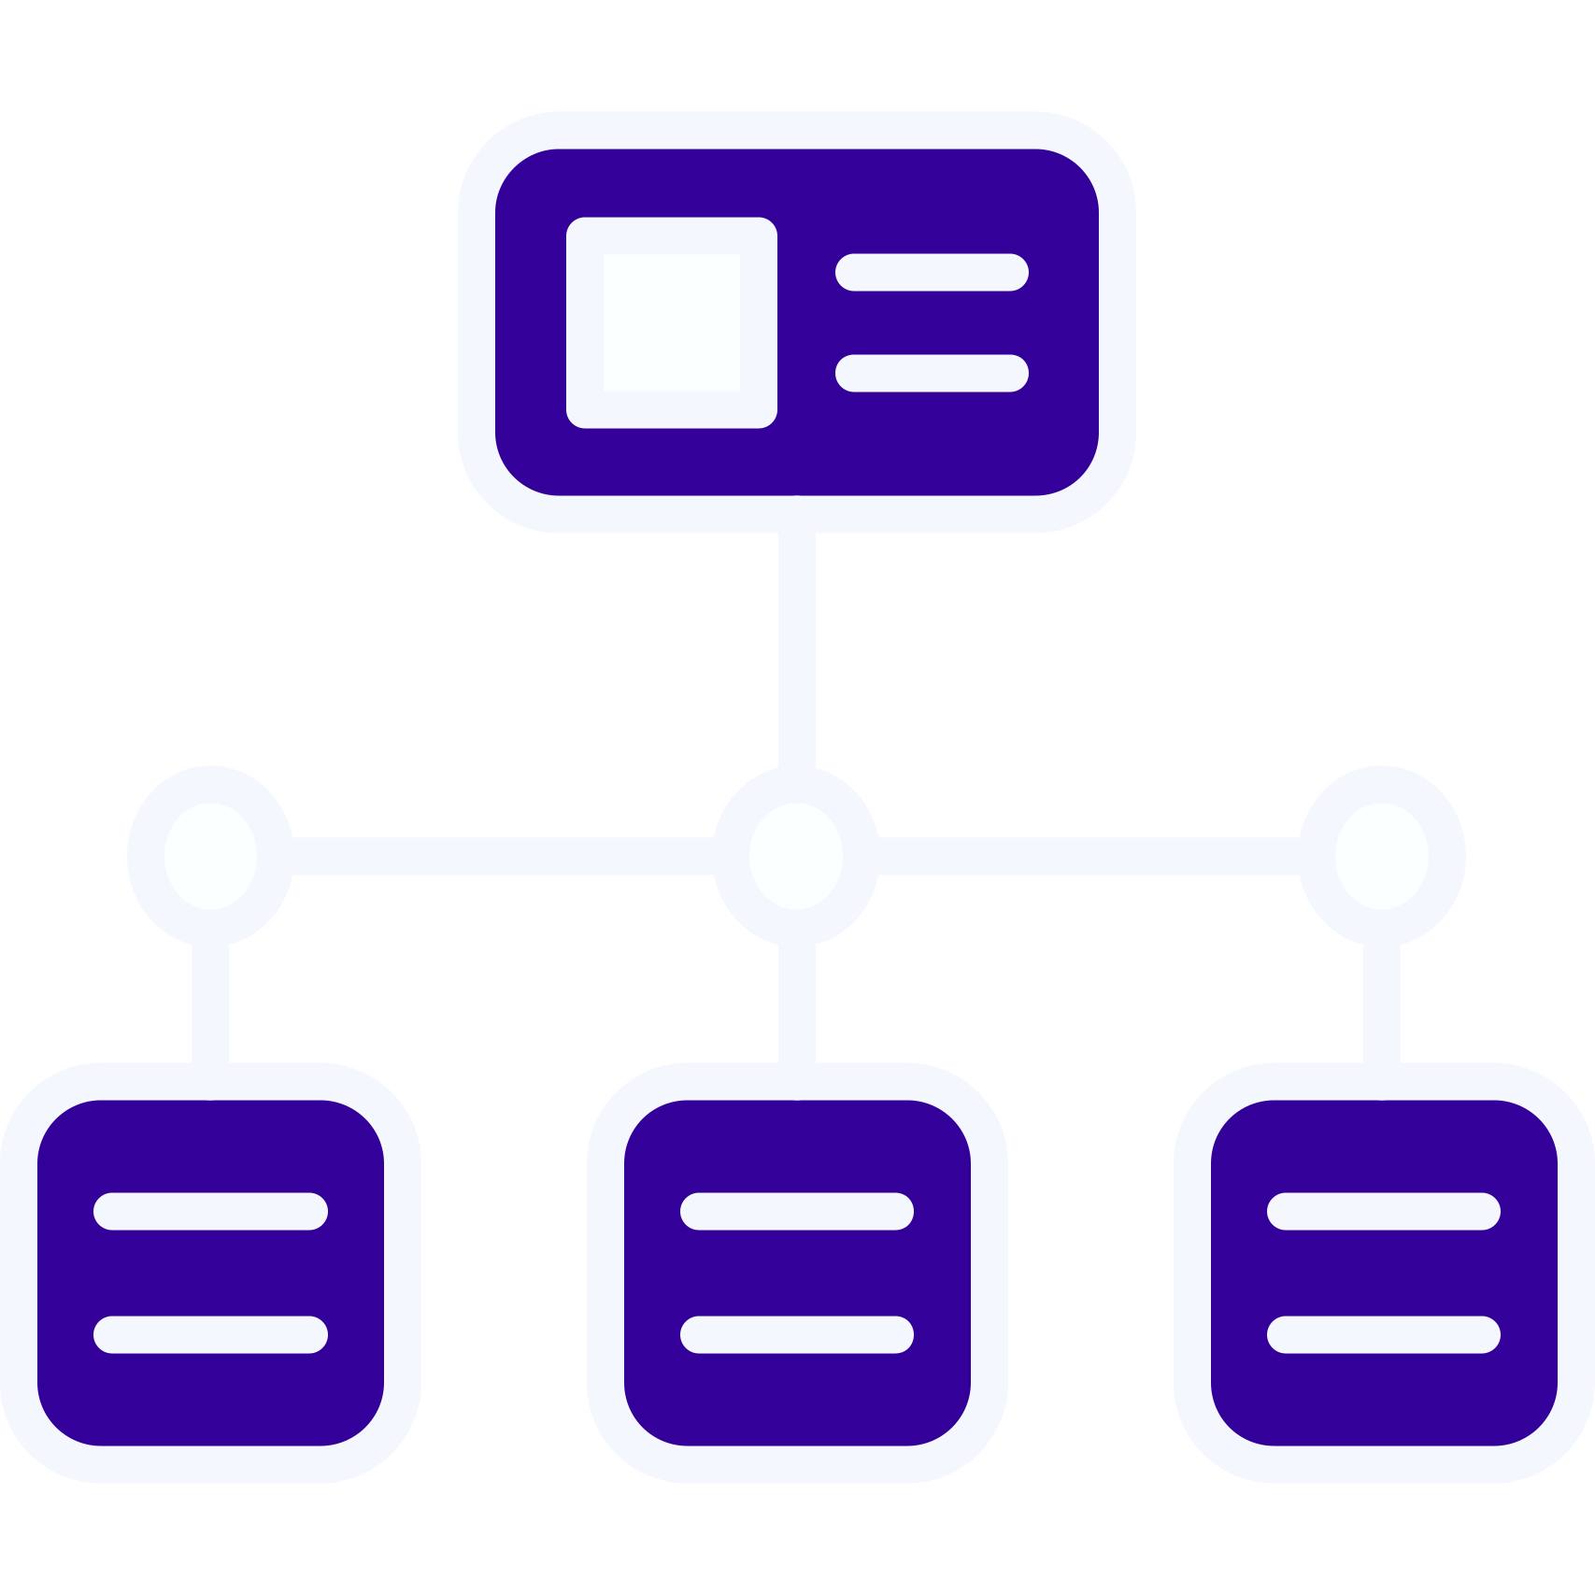





Your 2026 AI Adoption Roadmap
Foundation
Daily Usage
Use-Case Creation
Scale & Automation
Goal: Get ready for
AI adoption
Goal: Make AI part
of daily work
Goal: Turn experiments into repeatable workflows
Goal: Transform AI into
a company-wide system
Key Metrics: 100% access, 90% trained, 1 sponsor
Key Metrics: 80% active users, 3+ success stories, 10+ uses/user/week
Key Metrics: 5–10 use cases, 3+ workflows, 10–20 hrs saved/week.
Key Metrics: 10+ workflows, 100+ hrs saved/month, 3–5x ROI
Timeline: 4 weeks
Timeline: 2 months
Timeline: 2 months
Timeline: 4–6 months (ongoing)
01
02
03
04

Slide 10

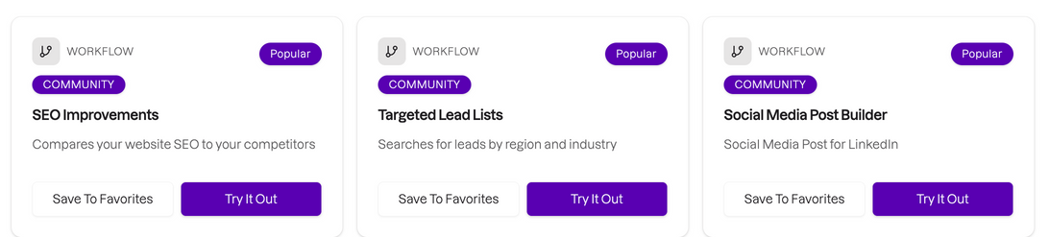
The Playbook
How to “Just get started”
3
Try 3 Apps, Workflows, or Agents in the Discover Community Workshop Page
1
Start using chat
2
Onboarding
These templates will give you a sense of the type of work AI can take off your plate.
Try Prompts with different LLMs
Become an AI Champion
How will AI impact my industry? (then continue the conversation)
Find trends in this spreadsheet (upload an xlsx or csv file) and tell me how many references there are to (insert a topic)
Summarize this document and put key info into a table, so I could explain it to someone with no experience in my industry (upload a PDF)
1
2
3

