Slide 1
DAY 0

Slide 2


Your AI Adoption Journey
The Hatz AI Kickoff

Slide 3

Secure AI platform
50 AI Models in 1 place
AI education
AI adoption framework
Easy wins
Chat with AI
Manage AI Agents
Build No-Code Workflows

Slide 4


































Integrations With Your Tech

Slide 5

What problems to solve for first
Important to move quick
Security
Adoption
Shadow AI is already happening. Employees use free tools and risk exposing sensitive data.
Even if you have AI access, the challenge is getting the whole team to actually use it effectively.
Notes:
🔐 Security
• “The first problem every business needs to solve for is security.”
• Right now, Shadow AI is already happening in almost every organization. Employees are using free AI tools without approval.
• That means sensitive data — customer records, financials, internal documents — is being pasted into platforms with no visibility and no controls.
• The risk isn’t theoretical. It’s already happening: companies are unknowingly leaking confidential data into public models.
• So the first step in any AI journey is to take back control. Give employees a secure AI environment where they can still get the productivity benefits of AI — but with guardrails, governance, and visibility.
• Think of it like email or file sharing: people will use it whether you sanction it or not. If you don’t provide a secure option, they’ll default to whatever is easiest.
👉 “If you don’t solve security first, AI adoption could actually increase your exposure — instead of creating value.”

Slide 6
How to solve
01
02
03
Secure AI environment for all your team
Track adoption
and usage
Training and use-case development for real business value

Slide 7
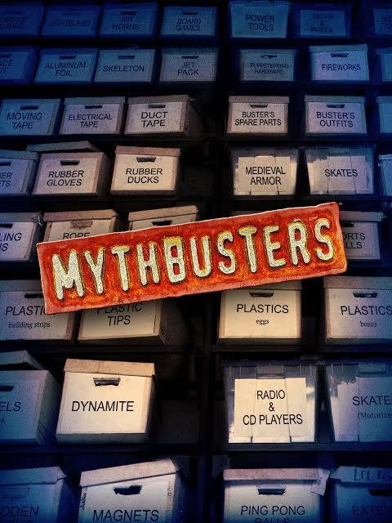
AI Myths
AI is big, complicated, and expensive.
It’s not for your business.
Your employees aren’t using it.
You should wait for it to develop more.
It will replace you.

Slide 8

AI Myths
AI is big, complicated, and expensive.
It’s not for your business.
Your employees aren’t using it.
You should wait for it to develop more.
It will replace you.

Slide 9
The truth is
AI is only getting better.
Your competitors are going to use it.
Your employees are already experimenting with it.
Your data is at risk without a policy in place.

Slide 10
The truth is
AI is only getting better.
Your competitors are going to use it.
Your employees are already experimenting with it.
Your data is at risk without a policy in place.
It is so incredibly easy to just get started.

Slide 11

“We tend to overestimate the effect of a technology in the short run and underestimate the effect in the long run.”
-Amara's Law
Coined in 1978

Slide 12
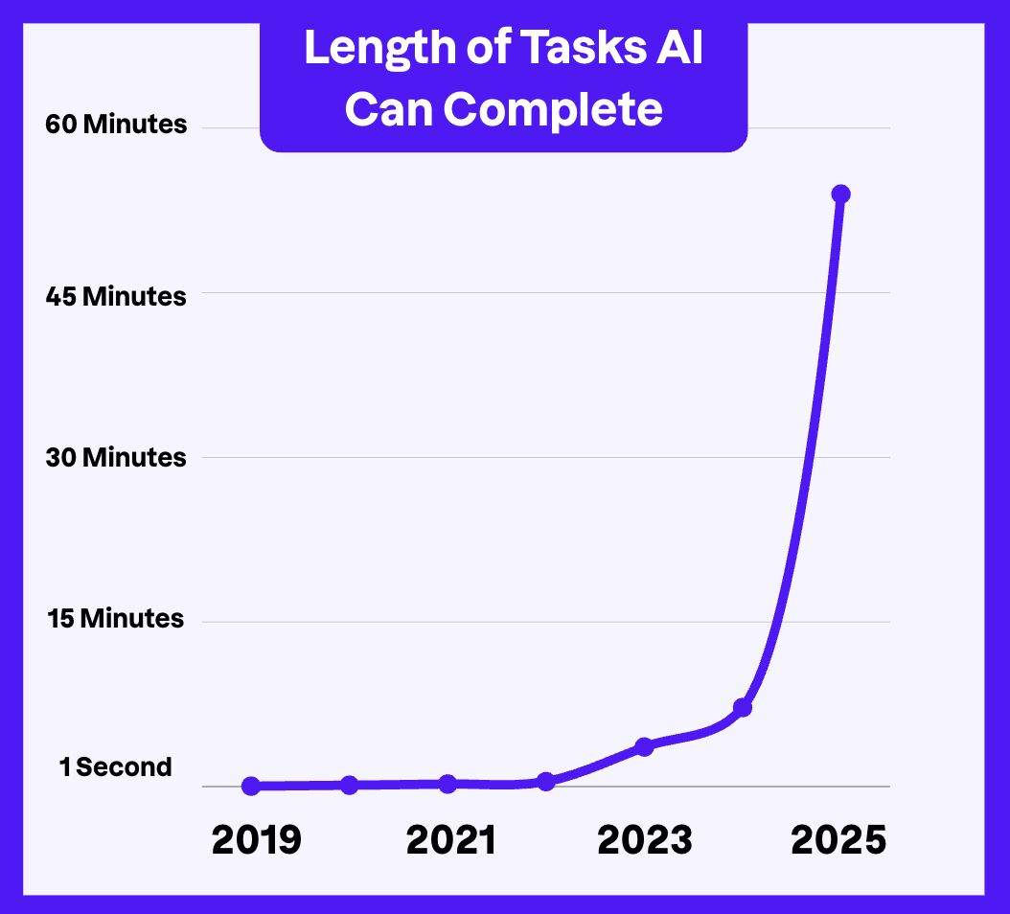

Those who saw the long term then are reaping the benefits now

Slide 13

What IS true about
AI adoption?

Slide 14
You Only Need 3 Things:
Curiosity
You’re here.
“Can I AI that?” is your new mantra
Humanity
You’re human.
AI only works with humans in the loop
Agility
You’re capable.
AI moves faster than you can master it

Slide 15
AI Adoption Is A Journey...

Slide 16
...to efficiency, time, & growth

Slide 17
AI Adoption Journey
Crawl
Walk
Run

Slide 18
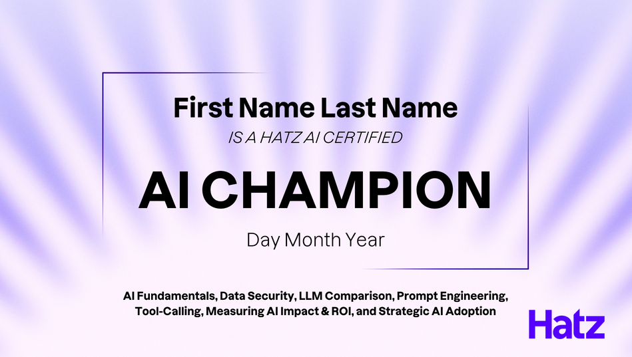
AI Champion Certification
A 60-minute AI education ‘onboarding’ for your entire company
Demystify AI concepts and terminology
Plan for AI Adoption + Expansion
Prompting for chat, tools, & images
Tracking AI’s impact and ROI

Slide 19
Crawl

Slide 20
CRAWL
Small wins today.
No convoluted workflows
No setup time
No training required

Slide 21
CRAWL
AI Use Cases That:
Have immediate realization of time to value.
Work for a large portion of the company.

Slide 22
CRAWL
AI Research
Image Generation
Brainstorming
File Analysis

Slide 23
Insert Relevant Use Case Video / Demo Here (optional)

Slide 24
CRAWL
Interactivity
Take 30 seconds and write down one task you or your team does every day that feels like a time-waster.
(e.g., writing social media posts, answering the same customer emails over and over, looking up info about a prospect or client)

Slide 25
Walk

Slide 26
WALK
More Experimentation
Basic workflows
Integrations
Process-specific

Slide 27
WALK
AI Use Cases That:
Are similar but require customization and hand holding.
Take more time to implement but can be recreated in multiple areas.

Slide 28
WALK
CRM Integration
HR Policy Expert
Basic Workflows
Certified Team

Slide 29
Insert Relevant Use Case Video / Demo Here (optional)

Slide 30
WALK
Interactivity
Pick a workflow or process in your department, then run this checklist:
What are the 5-15 steps?
Which steps are human-critical?
Which steps, if automated, free up the most time?

Slide 31
Run

Slide 32
RUN
AI-First Business
Processes are built with AI
Advanced workflows
Maximum ROI

Slide 33
RUN
AI Use Cases That:
Are unique to a specific person or business unit.
Have high impact but require specialty implementation.

Slide 34
RUN
Multi-Step Workflows
New Processes
Agents
AI-First

Slide 35
Insert Relevant Use Case Video / Demo Here (optional)

Slide 36
RUN
Interactivity
Pie in the sky. House on the moon. Boiling the ocean. Big picture. You get it.
How would you like to connect your current systems to AI to increase efficiency and innovate your industry?
How could you free up your team’s time by 20%?
If you could hire 3 new people, what would they do?

Slide 37
People are using free AI Tools...
AI Model Usage - Last 30 Days | Users | Queries
ChatGPT | 29 | 4157
Google Gemini | 3 | 23
Claude AI | 2 | 8
DeepSeek | 1 | 5
Totals | 35 | 4193
Average Queries Per Business Day | 221

Slide 38
Adoption Tips

Slide 39
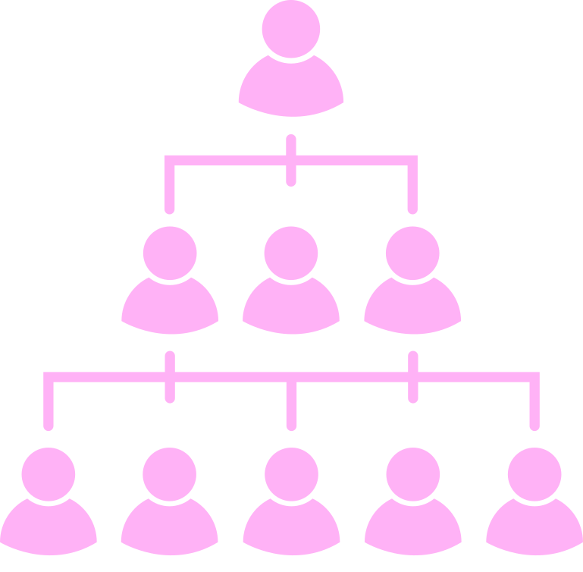
ADOPTION FOLLOWS THE ORG CHART
AI adoption begins with the CEO
Make leadership usage non-negotiable
Scale what works for the company execs

Slide 40
SUCCESS SCORECARD
(Define “Good” Up Front)
Track 3 things every week. Share results with the team.
Metric | Description | Goal | Result
Executive Usage | Full leadership team adoption Make AI usage a directive | 3 Wins
Time Saved / ROI | Hours recovered (self-reported + observed cycle times) | 10 minutes / person
Business Outcomes | Faster response times, higher throughput, lower cost-to-serve | 10% Improvement

Slide 41

AUTOMATE WITHOUT DEHUMANIZING
Adopting AI
Keep a human in the loop
Ask your team what work steals hours but doesn’t require a heavy human oversight
Replacing Humans
If your team had 10% of their time back, how could they use it?

Slide 42

CALL OUT ANTI-PATTERNS
Stop contrarian pushback before it kills AI adoption in your business.
What you Hear
Translation
“We don’t value our current team’s time.”
“We’ll hire an AI team first”
“Let’s automate everything.”
“Your job is at risk.”
“I won’t use AI unless it can do X, Y, and Z.”
“I’m unwilling to try.”

Slide 43

The Time To Start Is Now
Experimenting & Validating
Building Competency
Adopting
Innovating
Businesses that started 6 months ago
Businesses starting today

Slide 44
Crawling With Hatz

Slide 45


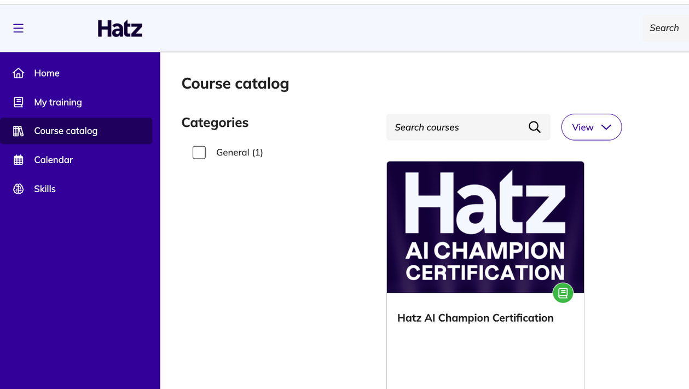
If you have not completed the training yet, do that first!
1
2
3

Slide 46
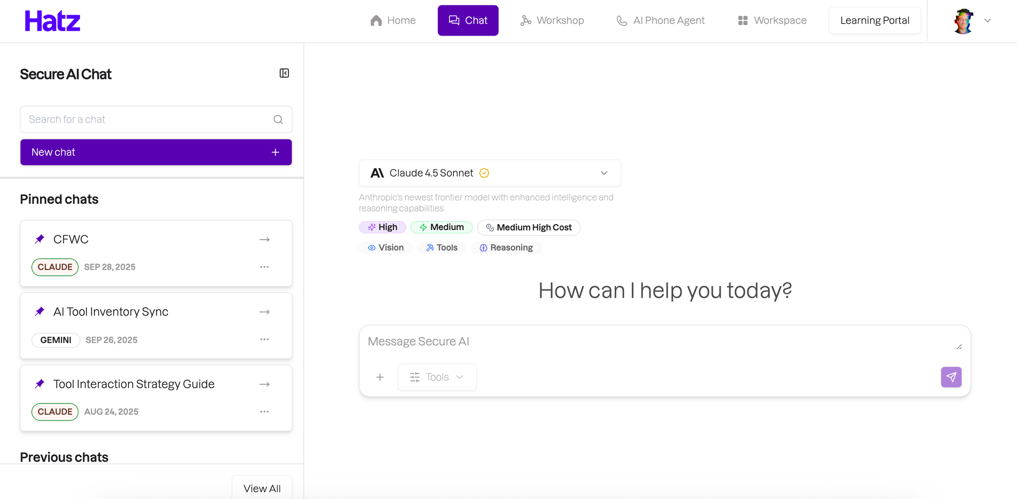
Explore the chat interface
LLMs
Integrations

Slide 47
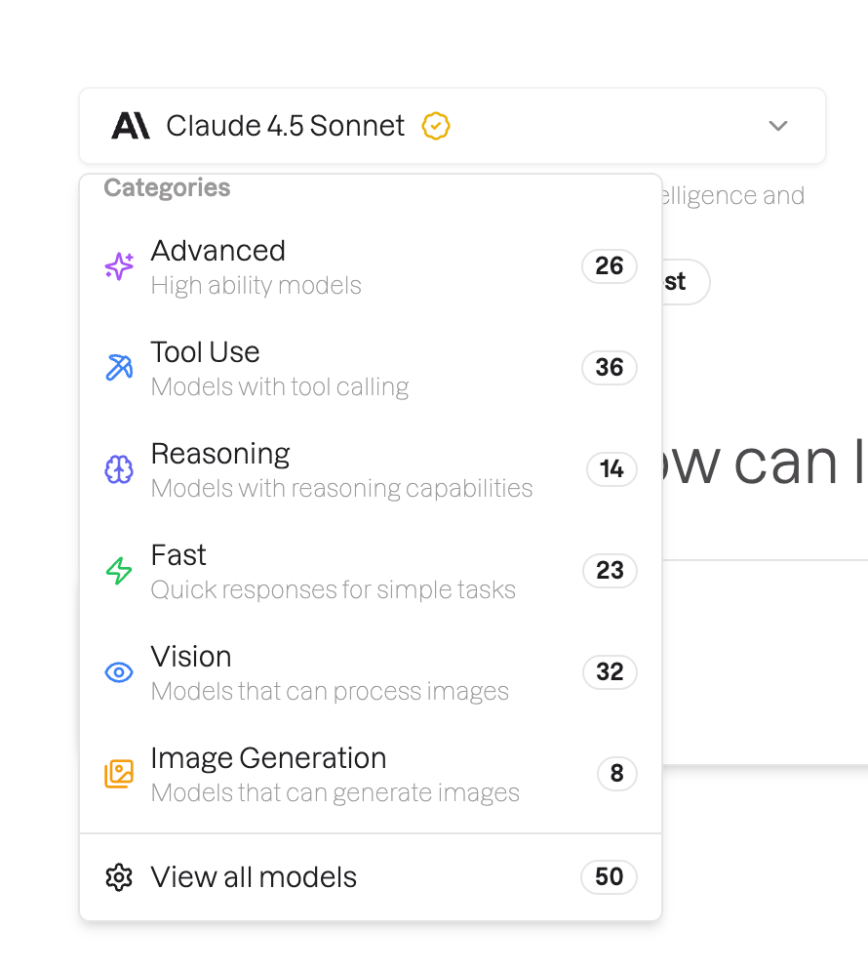
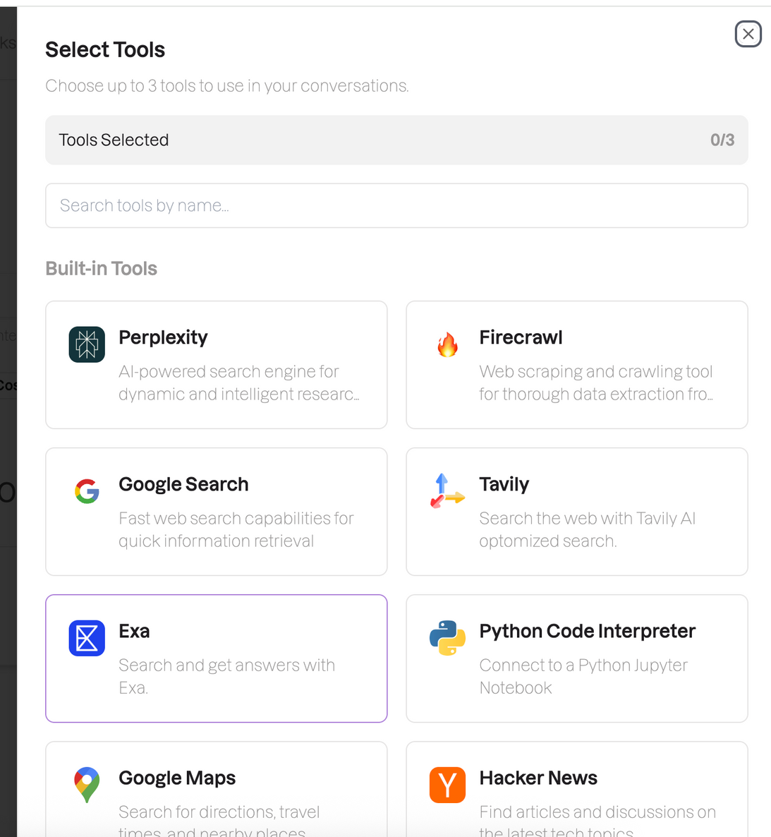

Slide 48
Tools for Internet search:
Exa
Tavily
Google Search
Firecrawl
Perplexity
Tool to generate PDF, PPT, DOCX, etc:
Python Code Interpreter
Tool to get help with Hatz
Hatz Workshop Assistant

Slide 49
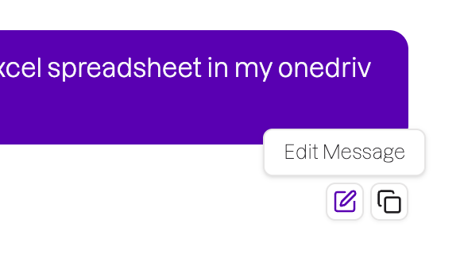

Branched chatting:
Change the LLM and re-generate for immediate LLM output comparison
Rewrite your prompt for an alternate option

Slide 50
Final Advice:
Ask AI how to use AI

Slide 51
Thank You

Slide 52
DAY 30

Slide 53
Your AI Adoption Journey
Use Case Ideation Workshop

Slide 54

AI Adoption Journey
Crawl
Walk
Run

Slide 55
Use Case Ideation Workshop Agenda
01
02
03
Document & Diagram Your Processes
Determine Where AI Can Fit Into Them
Make A Plan To Build & Track Impact

Slide 56
This exercise helps you get organized
You audit your existing processes and might find ways to streamline them
You’ll know where you’re spending your time (and what’s draining it)
You can set goals based on FACTS

Slide 57
Document & Diagram Your Processes

Slide 58
“Every day, I do [repetitive task] [number of times].”
Low-effort, high-value

Slide 59
Task
Number of Minutes
How Annoying? (1-5)
Times / Day
Task 1
Task 2
Task 3
Task 4
Task 5

Slide 60


Start thinking about the steps for each task
Task 1
Step 1
Step 2
Step 3
Task 2
Task 3
Task 4
Step 4
Step 5
Task 5

Slide 61
Example
Task
Steps
Research: 10 minutes
Copy: 10 minutes
Graphic: 20 minutes
Post to LinkedIn: 1 minute
"It's hard to come up with social media content and produce it fast enough."

Slide 62

Example
Task
Steps
Research: 10 minutes
Copy: 10 minutes
Graphic: 20 minutes
Post to LinkedIn: 1 minute
"It's hard to come up with social media content and produce it fast enough."

Slide 63



Diagram the process
Research: 10 minutes
Copy: 10 minutes
Graphic: 20 minutes
Post to LinkedIn: 1 minute
RESEARCH
Copy and paste
COMPILE IN DOC
Human Review
DESIGN GRAPHIC
POST TO LINKEDIN
Copy and paste
EDIT CONTENT

Slide 64
Determine Where AI Can Fit Into Them

Slide 65
Where Does AI Fit In?
RESEARCH
Copy and paste
“Can I AI that?”
COMPILE IN DOC
Human Review
DESIGN GRAPHIC
POST TO LINKEDIN
Copy and paste
EDIT CONTENT

Slide 66


AI integrations with web search, Reddit, etc can do the research
RESEARCH
Copy and paste
AI integrations with OneDrive can find my social media docs and update them
COMPILE IN DOC
Human Review
Keep a human in the loop
Back to AI for final copy editing
EDIT CONTENT
Use Nano Banana to generate an image based on the content
DESIGN GRAPHIC
Copy and paste
Save the image to LinkedIn
AI integration with LinkedIn can post
POST TO LINKEDIN

Slide 67
RESEARCH
Copy and paste
5 of 8 steps can be given to AI*
COMPILE IN DOC
Human Review
EDIT CONTENT
*You don’t need to be an AI expert - you just need to know what’s possible
DESIGN GRAPHIC
Copy and paste
POST TO LINKEDIN

Slide 68
Using your own diagrams, work in groups or individually to determine how Hatz can be leveraged.

Slide 69
How much time will this save me?
Research: 10 minutes
Copy: 10 minutes
Graphic: 20 minutes
Post to LinkedIn: 1 minute
RESEARCH
Copy and paste
COMPILE IN DOC
Human Review
EDIT CONTENT
Total: 40 minutes
DESIGN GRAPHIC
Copy and paste
POST TO LINKEDIN

Slide 70
How much time will this save me?
Research: 10 minutes
Copy: 10 minutes 5 minutes for human review
Graphic: 20 minutes
Post to LinkedIn: 1 minute
RESEARCH
Copy and paste
COMPILE IN DOC
Human Review
EDIT CONTENT
Total: 5 minutes
DESIGN GRAPHIC
35 minutes saved, or almost 90%
Copy and paste
POST TO LINKEDIN

Slide 71
Run the numbers for yourself.
What’s the potential impact of AI if you start with existing, repetitive tasks?

Slide 72
35 minutes X 5 Days = ~3 Hours / Week
3 Hours / Week X 5 Tasks = 15 Hours / Week
1/3 of your time back

Slide 73
Start with EXISTING processes.

Slide 74
Make A Plan To Build & Track Impact

Slide 75
Why track AI’s impact?

Slide 76
How will you know your prompts are effective if you aren’t tracking their use against anything?

Slide 77
What does “good” look like?
And what are we tracking?
Time measurements - minutes, hours, days saved
Cost calculations - labor, operational, or resource costs
Quality and accuracy metrics - error reduction, consistency improvements
Resource allocation - capacity increases, throughput improvements
Creative & strategic freedom – brainpower given back to your team to tackle big picture projects

Slide 78
It starts with a baseline.
Before AI
With AI
How much ...time? energy? money? ... is saved

Slide 79
Create a Priority Matrix
Use Case
Baseline
Potential
Percent
Ranking
Built By
1
2
3
4
5
25 min
35 min
40 min
15 min
10 min
20 min
25 min
35 min
5 min
7 min
80%
71%
88%
33%
70%
2
3
1
5
4
Oct 10th
Oct 20th
Oct 1st
Nov 1st
Oct 25th

Slide 80
Start building in Hatz.

Slide 81
Walking With Hatz

Slide 82
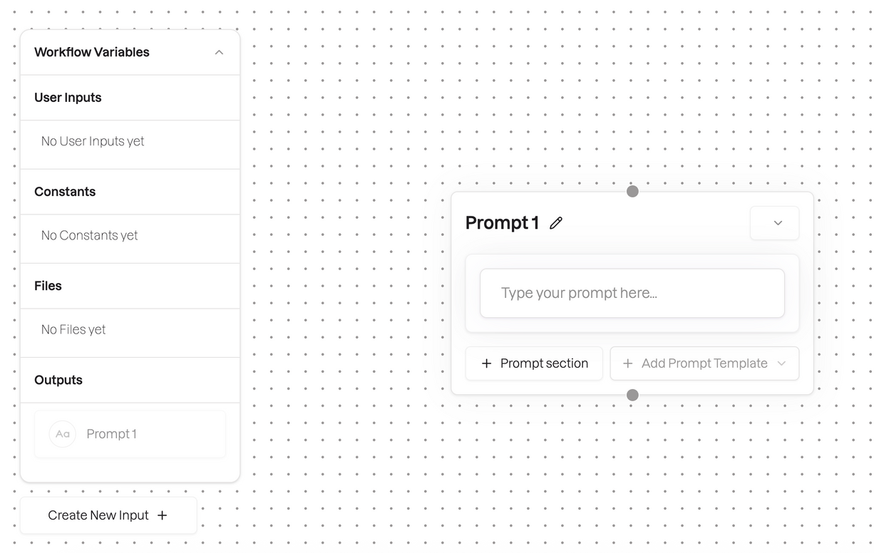
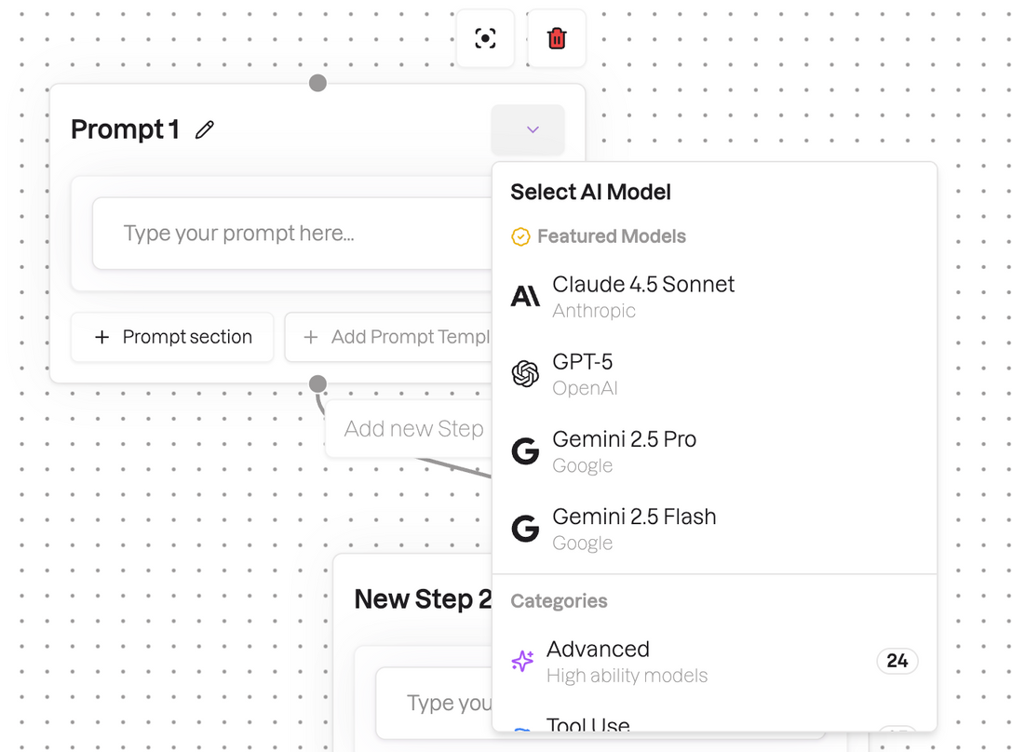
Workshop
Select an LLM

Slide 83
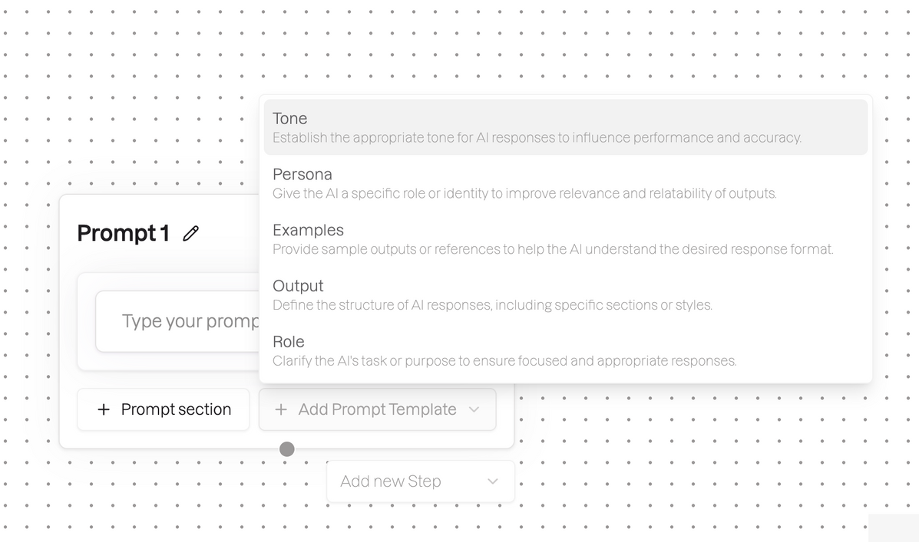
You can use prompt templates if you’re unsure how to get started.
Prompt sections can just help break up walls of text

Slide 84
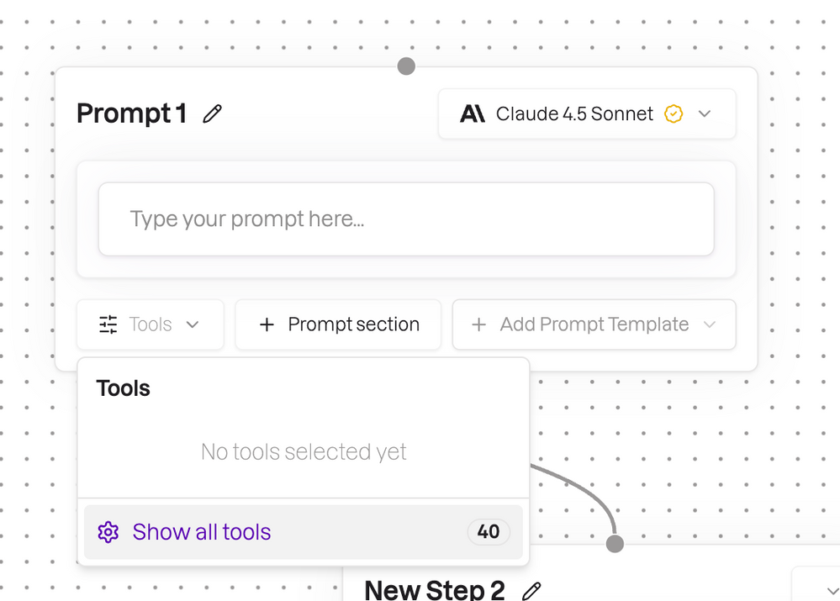
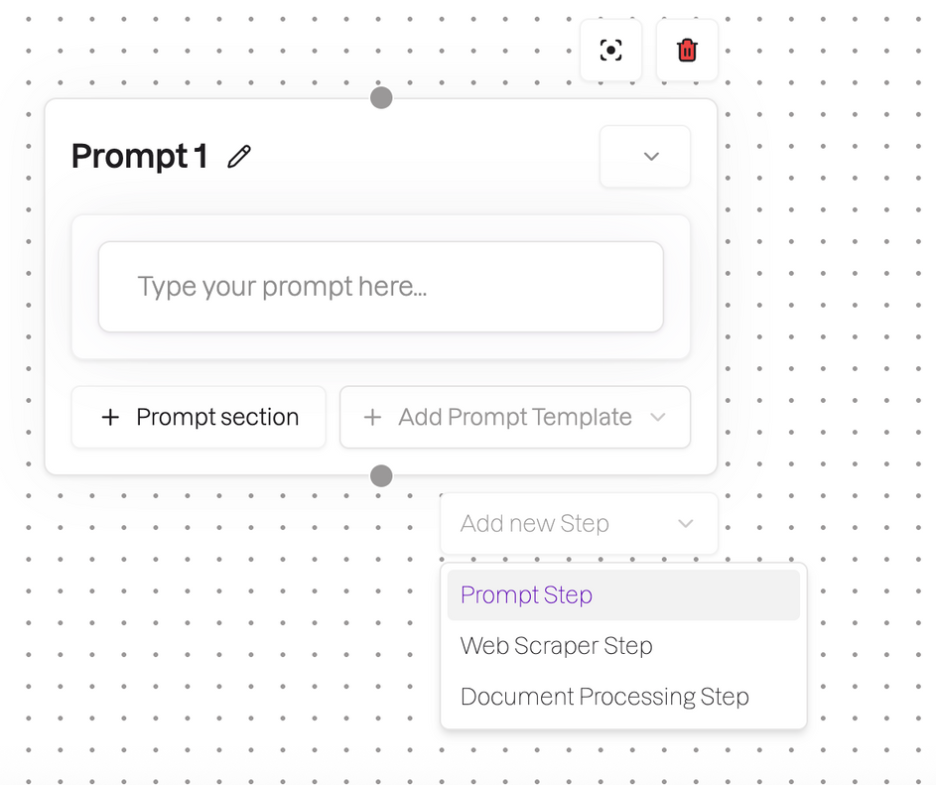
Select types of new steps in the workflow
Choose a tool for this specific step

Slide 85
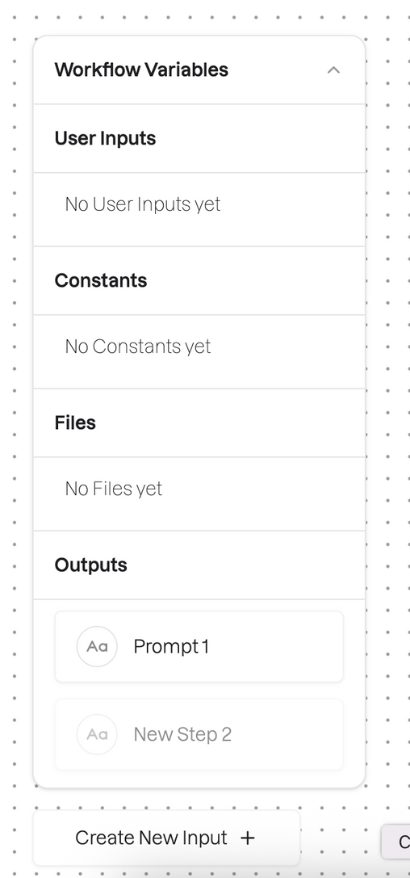
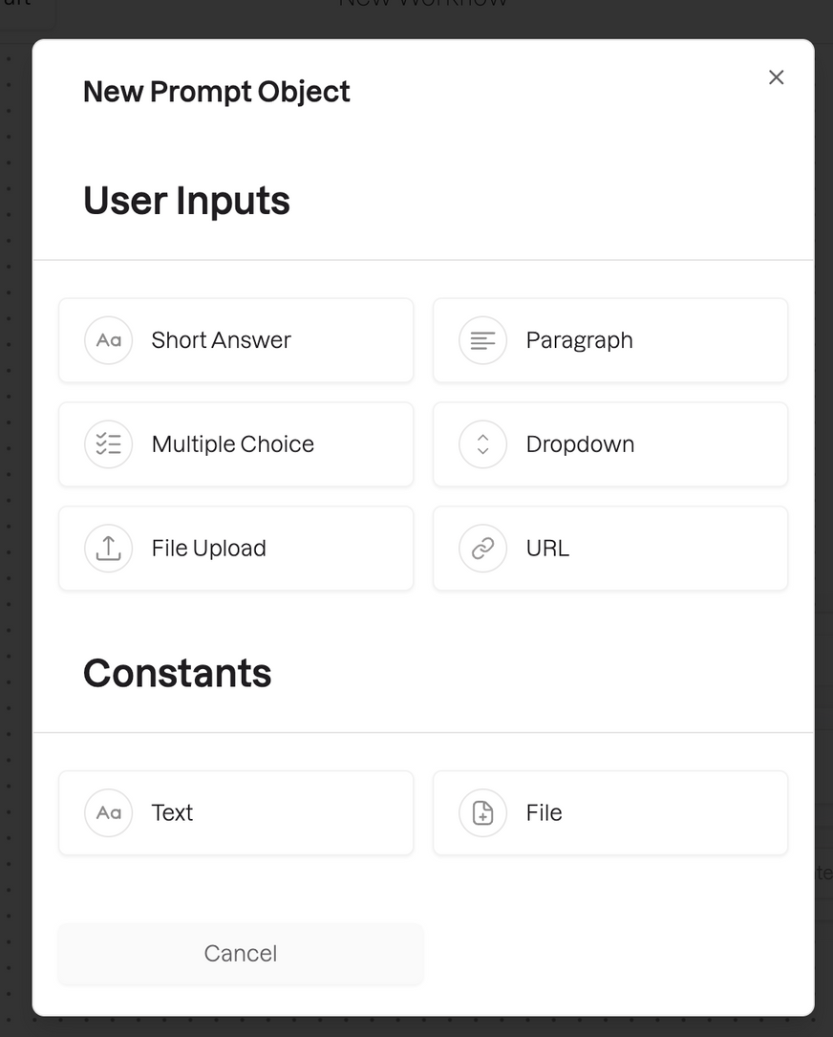
User inputs dictate how the user will interact with the Workflow.
Constants live “behind the scenes” with the prompts. These are static files you want the AI to reference.
Outputs let you take the output from a previous step and use it as a prompt in a future step.

Slide 86
Every week, check your progress:
Is the AI workflow / agent / app working?
How much time is it saving against your baseline?
Can you make it better with new features?
Where do you need help?

Slide 87
Thank You

Slide 88
DAY 60

Slide 89
Your AI Adoption Journey
Scale What Works

Slide 90
AI Adoption Journey
Crawl
Walk
Run

Slide 91
Scale What Works
This is part 3 of 3.
In the crawl - walk - run framework, you’re at run.
It’s time to get innovative!

Slide 92
By now, you should have:
Defined at least 5 use cases
Built them in Hatz
Begun tracking their impact
Iterated on them

Slide 93
Let’s look at what’s working and lean into it.

Slide 94
Organize your use cases like this:
Use Case
Baseline
Potential
v1 Results
1
2
3
4
5
25 min
35 min
40 min
15 min
10 min
20 min
25 min
35 min
5 min
7 min
20 min
30 min
25 min
2 min
9 min
Working Well
Working Well
Needs more work
Needs more work
Working Well

Slide 95
For the use cases that are working well, ask yourself why.
Why are they working?

Slide 96
Is it because...
The process was well-documented pre-AI, with clean data and easy to follow steps
01
You have a strong understanding of Hatz, and prompting in general
02
03
Something else - what?

Slide 97
Once you know why a use case is working, brainstorm how you can scale it:
In your own processes
In other departments

Slide 98
The best way to figure this part out? Ask AI.
Go to the chat and enable the Hatz Workhop Assistant
Tell it the name of your automation / workflow / agent and tell it how it is helping you
Then ask it to help you brainstorm ways you might be able to use something similar in a different area or department

Slide 99
The best way to figure this part out? Ask AI.
Also ask it to tell you about any new features you could use to improve the use case or make it more efficient
You can even get it to help you write prompts, and then the workflow or agent - all by itself

Slide 100
For the use cases that are NOT working well, ask yourself why.
Why aren’t they working?

Slide 101
Is it because...
01
Your data was messy and difficult for AI to follow
02
You weren’t sure how to get started with Hatz
03
Something else - what?

Slide 102
Same recommendation as before: ask AI.
Turn on the Hatz Workshop Assistant and ask it to find the use case that isn’t working (tell it the name)
Ask it to review the prompts and tell it what you’re trying to accomplish with Hatz
See if AI can find any areas for improvement or re-prompting

Slide 103
Thank You

Slide 104
DAY 90

Slide 105
Your AI Adoption Journey
New Hatz Features

Slide 106
How To Find New Features
Go to:
https://hatz-ai.canny.io/changelog
Check the dates on the changelog
Or
Sign up for new feature alerts here:
New Feature Alerts

Slide 107
New Features

Slide 108
NEW FEATURES
Feature Name
Feature Subtitle
Summary of what it does
include specifics if applicable
Image / GIF if applicable
Describe a use case using the new feature

Slide 109
How Can You Use This Feature To Improve Your Current Processes?

Slide 110
Thank You

