Slide 1


Security & Adoption
First Steps Toward AI Excellence

Slide 2

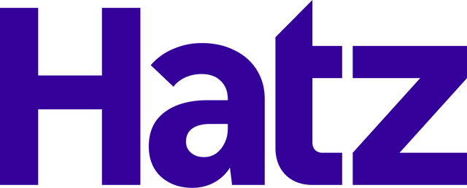
What problems to solve for first
Important to move quickly
Security
Adoption
Shadow AI is already happening. Employees use free tools and risk exposing sensitive data.
Even if you have AI access, the challenge is getting the whole team to actually use it effectively.
Notes:
🔐 Security
• “The first problem every business needs to solve for is security.”
• Right now, Shadow AI is already happening in almost every organization. Employees are using free AI tools without approval.
• That means sensitive data — customer records, financials, internal documents — is being pasted into platforms with no visibility and no controls.
• The risk isn’t theoretical. It’s already happening: companies are unknowingly leaking confidential data into public models.
• So the first step in any AI journey is to take back control. Give employees a secure AI environment where they can still get the productivity benefits of AI — but with guardrails, governance, and visibility.
• Think of it like email or file sharing: people will use it whether you sanction it or not. If you don’t provide a secure option, they’ll default to whatever is easiest.
👉 “If you don’t solve security first, AI adoption could actually increase your exposure — instead of creating value.”

Slide 3
How to solve
01
02
03
Secure AI environment for all your team
Track adoption
and usage
Training and use-case development for real business value

Slide 4
People are using free AI Tools...
AI Model Usage - Last 30 Days | Users | Queries
ChatGPT | 29 | 4157
Google Gemini | 3 | 23
Claude AI | 2 | 8
DeepSeek | 1 | 5
Totals | 35 | 4193
Average Queries Per Business Day | 221

Slide 5


How do AI models get better?
  They gain access to more data
  When people use free AI tools (and even some paid) it trains on their data
  LLMs can add your confidential info to their training data

Slide 6
Loss of intellectual property
  Your data is accessible by anyone
  Confidential info is exposed
  Company data goes with employees when they leave

Slide 7
Data security should be a foundational consideration, not an afterthought.

Slide 8
Do you know how your team is using AI?
And can you say for sure your data is private?

Slide 9
YOUR LOGO
Partnered to bring you:
  Your Secure AI platform
  50 AI Models in 1 place
  AI education
  AI adoption framework
  Easy wins
Chat
Workflows
Agents
Phone Agent
Integrations
Certifications

Slide 10
How We Think About AI Adoption
CRAWL
WALK
RUN
AI Use Cases:
  That have immediate realization of time to value.
  That work for a large portion of the company.
AI Use Cases:
  That are similar but require customization and hand holding.
  That take more time to implement but can be recreated in multiple areas.
AI Use Cases:
  That are unique to a specific person or business unit.
  That have high impact but require specialty implementation.
Meet Your Staff Where They Are
Notes:
“Once you’ve got security handled, the next step is adoption.
Here’s where most businesses struggle:
• A few people might try AI, but it never spreads across the whole team.
• Or employees don’t know how to use it effectively.
That’s where we come in.
We help businesses with 15 or more employees roll out AI across the entire organization.
Here’s how we do it:
• One easy button → every employee gets secure AI access instantly.
• Tracking & visibility → you can see who’s using it and how.
• Education at scale → your team gets training and guided use cases.
• Empowerment → we help your team develop their own AI use cases that make their day-to-day work easier and more productive.”

Slide 11
CRAWL
AI Research
Image Generation
Brainstorming
File Analysis

Slide 12
Insert Relevant Use Case Video / Demo Here (optional)

Slide 13
WALK
CRM Integration
HR Policy Expert
Basic Workflows
Certified Team

Slide 14
Insert Relevant Use Case Video / Demo Here (optional)

Slide 15
RUN
Multi-Step Workflows
New Processes
Agents
AI-First

Slide 16
Insert Relevant Use Case Video / Demo Here (optional)

Slide 17
Questions?

