Slide 1


AI-Powered Growth
AI Activation Playbook
Notes:
🌍 1. Opening Context
“We’re seeing a huge push among MSPs to lead their customers into AI adoption. Hatz helps MSPs bring secure, business-ready AI to their clients — not just individual use cases, but organization-wide adoption.”
⸻
💬 2. Core Discovery Questions
🏢 Business Overview
• Tell me a bit about your business — size, customer base, and how you currently support them with cloud, security, or productivity tools.
• How are you seeing AI come into your customers’ world? Are they asking about it yet?
• Have you started thinking about AI as a service or revenue stream for your MSP?
⸻
🏢 “You won’t believe this…”
Right now, there’s a very small window open for MSPs.
Most of your customers are either:
• Not using AI at all, or
• Using it in an unmanaged, ungoverned way
That creates a huge opportunity—for someone.
The MSPs who move now will become the provider of AI for their customers.
The ones who wait will end up supporting whatever their customers choose without them.
And here’s the key shift:
This is not about selling one AI deal at a time.
That approach is too slow—and you’ll miss the moment.
The MSPs winning right now are doing one thing differently:
They’re using auto-provisioning to turn on AI across their entire customer base quickly.
Not perfectly. Not all at once. But fast.
⸻
Then move into discovery:
“Let me ask you—where are you today in terms of rolling AI out across your customer base?”
“What’s stopping you from turning this on for a broader group of customers right now?”
“If we could give you a way to activate 50–100% of your customers over the next 60 days, how would that change your business this year?”
⸻
Close the setup with conviction:
“The opportunity isn’t in one or two customers.
It’s in becoming the AI provider for all of them—and auto-provisioning is how you get there.”

Slide 2
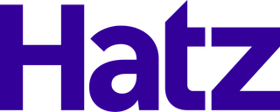
How we put MSPs in the AI Business
01
02
03
Curation of AI Tools
Secure AI
Sales Acceleration

Slide 3








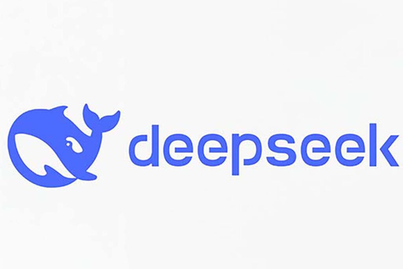
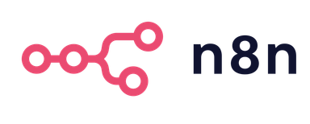
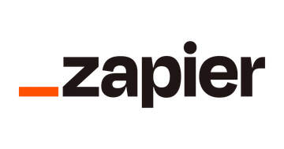
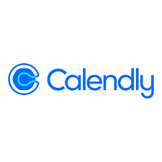
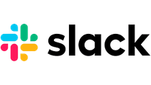
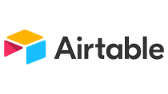
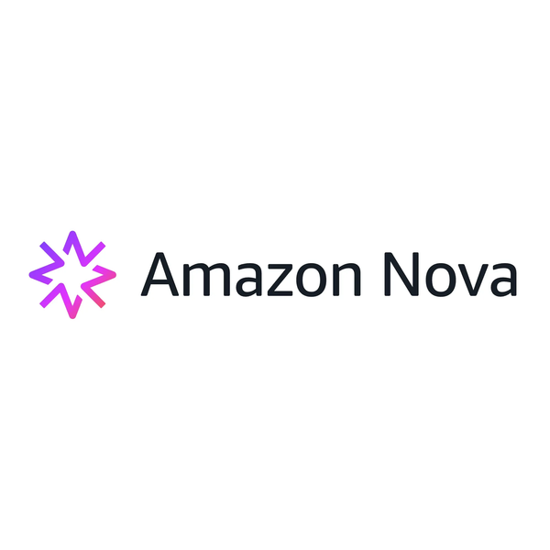


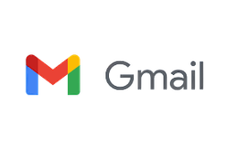

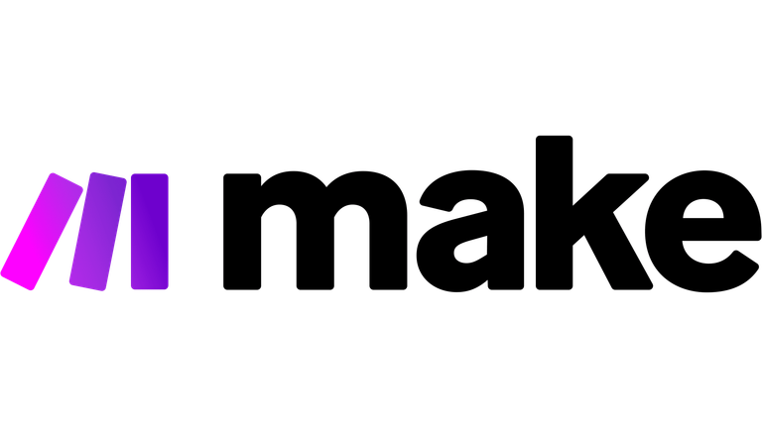
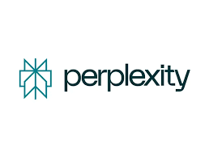
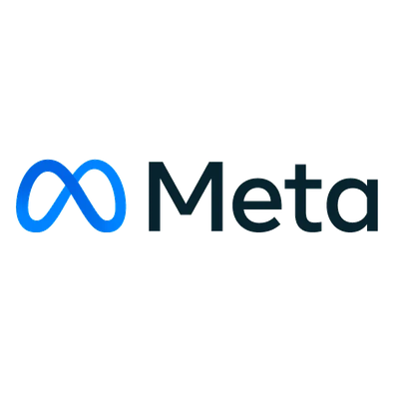

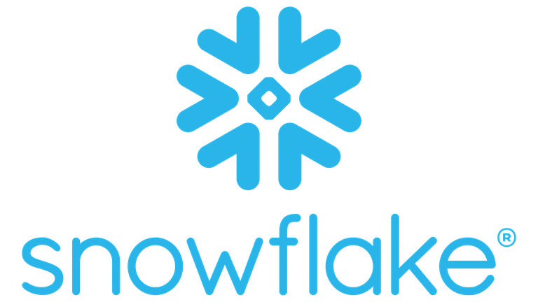
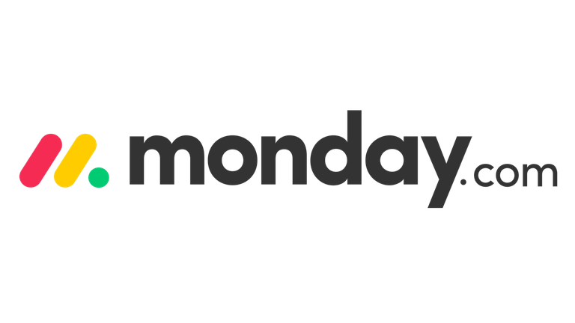
What Is Hatz?
Curation of AI in One Platform: No-Code Chat, Workflows, and Agents
More than 70 Secure AI Models in one place
More than 75 integrations with your data

Slide 4
What problems to solve for first
Important to move quick
Security
AI Adoption
Shadow AI is already happening. Employees use free tools and risk exposing sensitive data.
Even if you have AI access, the challenge is getting the whole team to actually use it effectively.

Slide 5
The Risk of Doing Nothing is Too Big to Ignore
Your employees are already using AI. The question is whether it’s approved.
We see it.
You should too.
You have a
responsbility.
Take Action .
Simple to adopt.
Easy to evaluate.
We have visibility across customer environments and see Shadow AI tools are already being used without your knowledge.
This creates real risk.
Sensitive company, customer, and financial data can be exposed.
You've worked hard to protect your business.
Ignoring unauthorized AI usage is a major risk and liability.
Your customers are counting on you to act.
We're enabling a secure, approved AI platform for all your employees.
Backed by a clear AI policy, Hatz is designed to reduce the risk of data leaving your organization, while still empowering your team.
A 30-day no-charge evaluation, with access to multiple leading AI models.
Your team can experience the value firsthand.
If you choose not to proceed, we'll simply ask you to sign a waiver.
Don't leave your data exposed. Let's turn on secure AI and protect what you've built.

Slide 6
How to solve
01
02
03
Secure AI environment for all your team
Track adoption
and usage
Education and use-case development for real business value

Slide 7
How We Think About AI Adoption
CRAWL
WALK
RUN
AI Use Cases:
  That have immediate realization of time to value.
  That work for a large portion of the company.
AI Use Cases:
  That are similar but require customization and hand holding.
  That take more time to implement but can be recreated in multiple areas.
AI Use Cases:
  That are unique to a specific person or business unit.
  That have high impact but require specialty implementation.
Meet Your Staff Where They Are

Slide 8
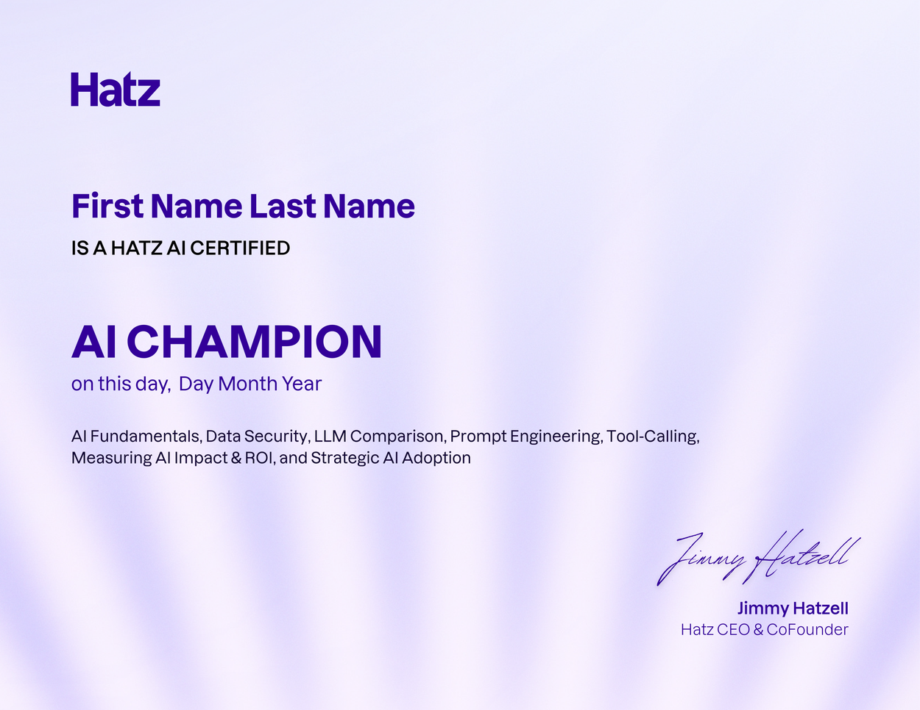
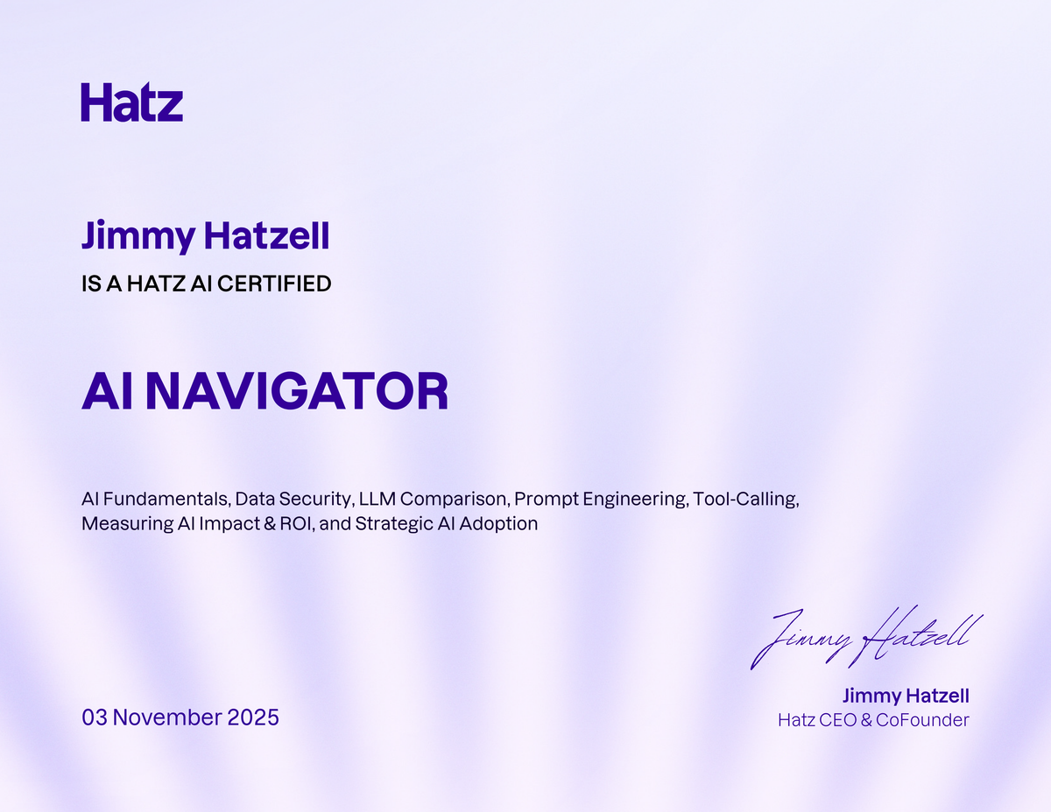
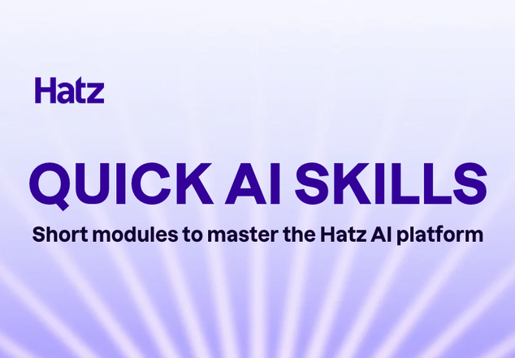
Onboarding
A 60-minute AI education ‘onboarding’ for your MSP and your clients
Baseline AI IQ
Onboard w/Hatz
Build your skills
1
2
3

Slide 9
Your 2026 AI Adoption Roadmap
Foundation
Daily Usage
Use-Case Creation
Scale & Automation
Goal: Get ready for
AI adoption
Goal: Make AI part
of daily work
Goal: Turn experiments into repeatable workflows
Goal: Transform AI into
a company-wide system
Key Metrics: 100% access, 90% trained, 1 sponsor
Key Metrics: 80% active users, 3+ success stories, 10+ uses/user/week
Key Metrics: 5–10 use cases, 3+ workflows, 10–20 hrs saved/week.
Key Metrics: 10+ workflows, 100+ hrs saved/month, 3–5x ROI
Timeline: 4 weeks
Timeline: 2 months
Timeline: 2 months
Timeline: 4–6 months (ongoing)
01
02
03
04

Slide 10
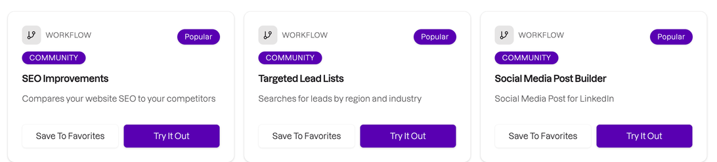
The Playbook
How to “Just get started”
3
Try 3 Apps, Workflows, or Agents in the Discover Community Workshop Page
1
Start using chat
2
Onboarding
These templates will give you a sense of the type of work AI can take off your plate.
Try Prompts with different LLMs
Become an AI Champion
  How will AI impact my industry? (then continue the conversation)
  Find trends in this spreadsheet (upload an xlsx or csv file) and tell me how many references there are to (insert a topic)
  Summarize this document and put key info into a table, so I could explain it to someone with no experience in my industry (upload a PDF)
1
2
3

Slide 11
How to Execute
You’ve seen what’s happening. This is how to execute — when you’re ready.
Step 1: Get Your Team Ready
Step 2: Roll It Out to Customers
  Turn on Hatz internally and drive daily usage
  Reach 60%+ adoption (or 20+ active users)
  Complete 90%+ onboarding
  Ensure each user connects at least 2 integrations
  Launch the Auto-Provisioning Program
  Pre-assign packs across your customer base
  Run a 30 day adoption push
  Support with access, training, and onboarding
Your team is confident using AI in real workflows
Customers live, using AI, and generating recurring revenue
This is not a future plan — this is what winning MSPs are doing today.

